Slide 1
The Power Of Bash
By: Alwyn Malachi Berkeley Jr.
Date: 09/09/09

Slide 2

Purpose
Very Light Overview Of Bash
Benefits Of Bash
Exposure To Scripting
Influence Use Of Bash
Notes:
Insert a map of your country.

Slide 3
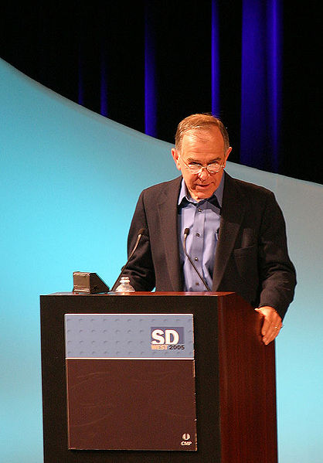
History: In The Beginning
Stephen Bourne 1977
Not V5 but VII
Thompson Shell
Significant Improvements:
Loops
Command substitution
No limit string lengths
Control over i/o 2> for instance
Notes:
Insert a picture of one of the geographic features of your country.

Slide 4

History: In the End
Brian Fox 1987
More Features:
Brace expansion (echo h{a,i,o,u}t)
C Shell Features
Korn Shell Features
$PPID
$RANDOM
Command Line completion
History

Slide 5
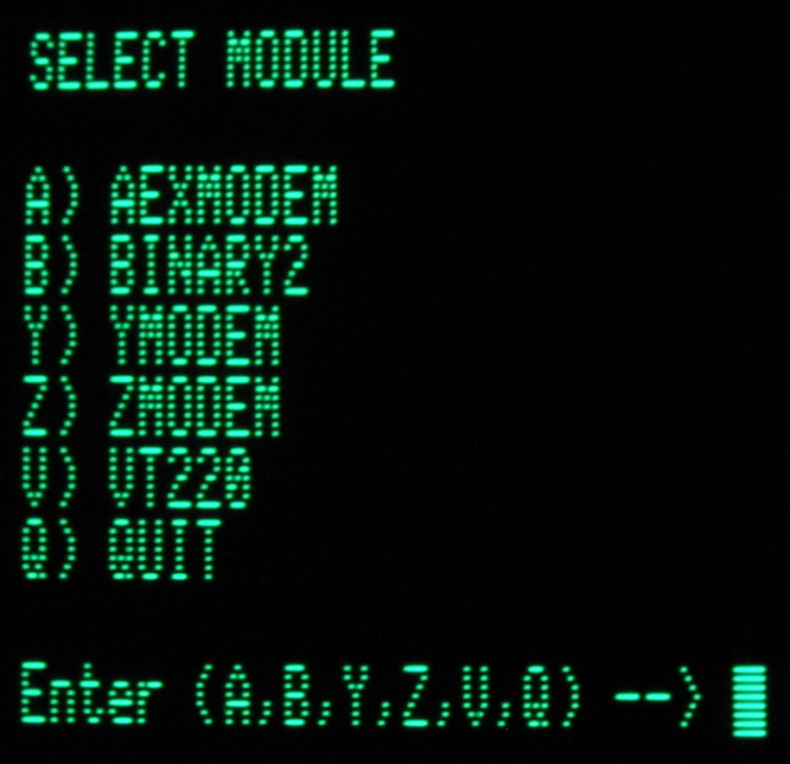
Terminal/CLI
Command Line Interface (CLI)
Tell about the typical weather patterns in your country throughout the calendar year.
Cd
pwd
Ls
History
mkdir/rmdir
Cat
head/tail
Notes:
Insert a picture illustrating a season in your country.

Slide 6
Now The Fun Happens!
Scripting
Repetitive, Annoying, Tasks
What can it do?
Get my external IP
Check if program exists
Switch desktop
Play music
Download information
Convert file formats
Rules:
(NOT SET IN STONE)
In order Top To Bottom
Every line is a statement
Every statement begins with a program name or function name
You can do in a bash script everything you can do in bash
It is like any other programming language (functions, variables, control structures etc.)
Notes:
Insert a picture of an animal and or plant found in your country.

Slide 7

Easy Examples
Hello World
Nth Line Simple
Nth Line Generalized
extractsecond
Notes:
Insert a picture illustrating a custom or tradition here.

Slide 8

Harder Example
Amazon rates books
Stars is a program that gives you the a book's rating from the terminal
Lets Trace Stars
Notes:
Insert a picture of the head leader of your country.

Slide 9

Questions?
Are there any questions?
Further Resources:
The Linux Documentation Project
http://en.tldp.org/HOWTO/Bash-Prompt-HOWTO/
http://tldp.org/LDP/abs/html/
Notes:
Insert a picture that illustrates some part of your country’s economy.

